Slide 1
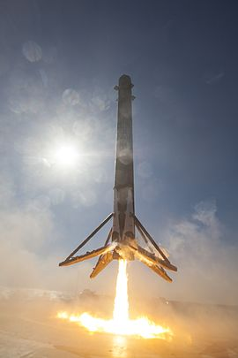






SpaceX Falcon 9 Launch Outcomes Insights
Tanya Radkey
2021-12-12

Slide 2



Table of Contents
Executive Summary
Introduction
Methodology
Data Collection and Wrangling
EDA and Interactive Visual Analysis
Predictive Analysis
Results
EDA with Visualization Results
EDA with SQL Results
Interactive Map
Dashboard
Predictive Analysis
Discussion
Conclusion
Appendix
References

Slide 3

EXECUTIVE SUMMARY
The business model for SpaceX that has allowed them to offer clients a significantly lower price point for launching payloads into space is based on reuse of the first stage rocket.
The key point in being able to reuse the first stage for a future launch, is achieving a successful launch/landing outcome for the first stage.
The goal of this analysis is to determine what factors influence successful launch outcomes for SpaceX, so that these factors can be used to predict future launch outcomes.
These predictions can be used to calculate launch costs, and to establish pricing for clients, and profit margins.

Slide 4

INTRODUCTION
Background
As identified in the assignment parameters
Space X advertises Falcon 9 rocket launches on its website with a cost of 62 million dollars; other providers cost upward of 165 million dollars each, much of the savings is because Space X can reuse the first stage. Therefore if we can determine if the first stage will land, we can determine the cost of a launch. This information can be used if an alternate company wants to bid against space X for a rocket launch. In this lab, you will create a machine learning pipeline to predict if the first stage will land given the data from the preceding labs.
Purpose
The purpose of this analysis is to identify the various factors that influence successful launch outcomes for SpaceX.
A secondary purpose is to identify the best performing algorithm for machine learning for outcome prediction for SpaceX launch outcomes.

Slide 5
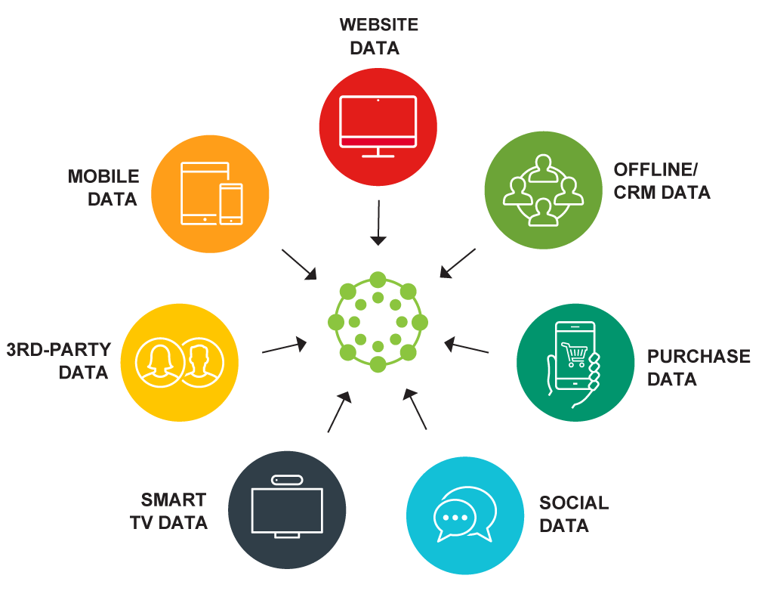
METHODOLOGY Data Collection and Wrangling
Data Collection
Data was webscraped from Wikipedia page “List of Falcon 9 and Falcon Heavy launches” dated 2021-06-09. The webscraped data contained 121 samples, and 5 different launch sites.
Use of a RestFUL API, specifically SpaceX REST API to collect data (90 samples)
BeautifulSoup was used to parse the webscraped data and create Pandas dataframes.
Data Preparation
The provided dataset “dataset_part_1.csv” containing 90 samples using 3 different launch sites was the base for the data preparation.
Missing values were identified by attribute
Attribute types were identified
Landing Outcomes were identified, categorized as “bad outcome” (value 0) or not, and a landing outcome label was added to the dataframe.
Training labels were identified

Slide 6

METHODOLOGY EDA and Interactive Visual Analytics
Data Analysis
Exploratory Data Analysis
Data Feature Engineering
Examination of landing success rate by flight number, launch site, orbit, and payload mass (kg) was undertaken using scatterplots.
Examination of success rate by orbit type using mean success rate in bar chart format.
SQL analysis of outcomes by type for a selected period (additional SQL analysis tasks provided in the Appendix)
Launch sites location analysis using an interactive Folium map (outcomes, and location and proximities of a launch site)
Interactive launch records analysis using Plotly Dash.

Slide 7
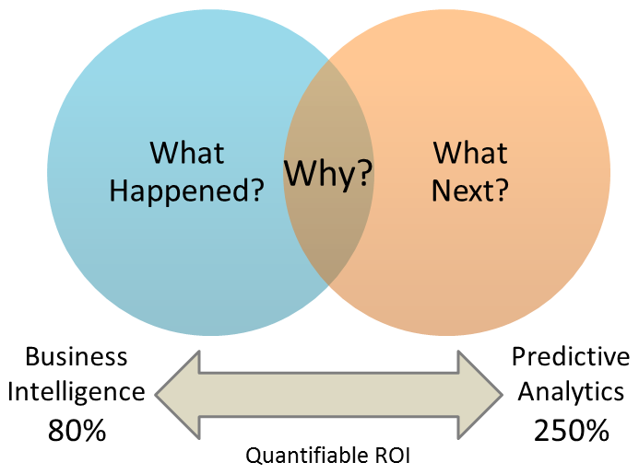
METHODOLOGY Predictive Analysis
Prediction
Data was converted to a NumPy array
Data was preprocessed using StandardScalar, fit, and transform
Train/Test split was created, using a 20% test size parameter
Logistic Regression Analysis conducted
Vector Machine Object Analysis was conducted
Decision Tree Classifier Analysis was conducted
K Nearest Neighbors Analysis was conducted
Accuracy for each analysis method on the Test split was calculated

Slide 8
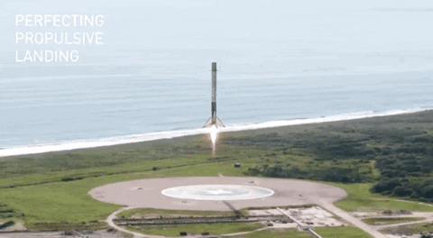
RESULTS
The goal is to determine if the first stage will land, the factors that influence successful launch/landing, and the machine learning algorithm that will best predict successful outcomes.

Slide 9
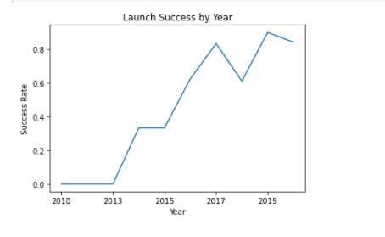
EDA with Visualization Results
Launch Success Over Time
The launch success rate improved with the passage of time. The data in graph form shows a trend of increased success from 2013 to 2020, with a dip in 2018.
Following is a review of the drivers behind the increased success rate, and the dip in the success trend in 2018.

Slide 10
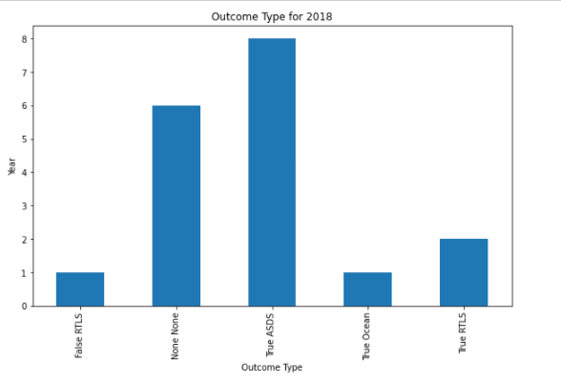
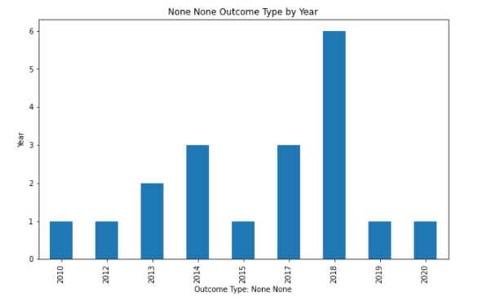
2018 Launch Success Trend Variance
2018 Launch Success Trend Variance
Viewing the Outcomes for 2018, the « bad outcome » category with the largest count was « None None » (i.e., where there was no attempt to land the unit).
Viewing the « None None » instances by year, there was a higher number of « no attempts » (i.e., « None None » outcomes for 2018, which depressed the launch success rate for 2018.

Slide 11
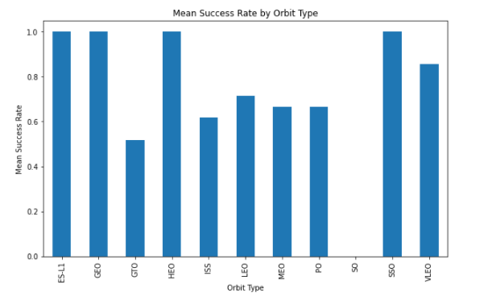
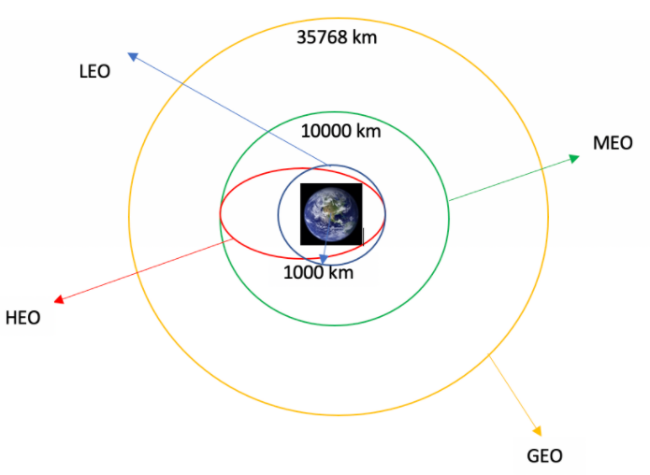
Success Factor: Orbit Type
Not taking year into account, there are orbit types that have a higher success rate than others: ES-L1, GEO, HEO, SSO, VLEO (to a lesser extent)

Slide 12
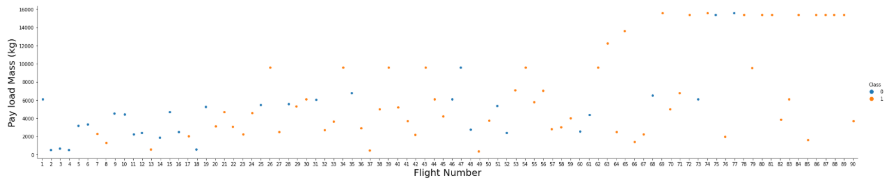
Success Factor: Flight Number (Time + Experience)
Assumption that lessons learned from previous flights are applied to the next flight, thus evolving the mission plans and liklihood of success.
The scatterplot shows fewer undesired outcomes as flight number (time + experience) passes.

Slide 13
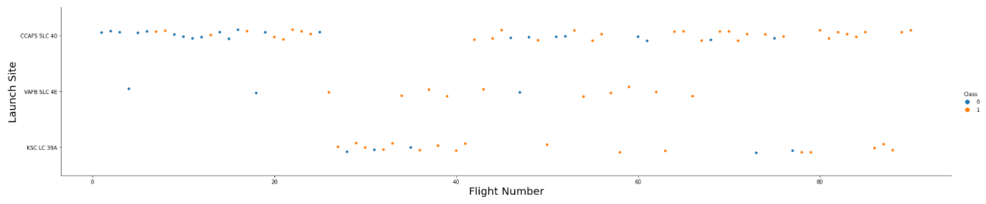
Success Factor: Flight Number (by Launch Site)
The scatterplot shows that CCAFS SLC 40 has a lower success rate. However, the majority of the initial flights were launched from this site. Therefore, this site bears the brunt of the learning curve (i.e., initial failures).
The scatterplot shows no usage of launch site VAFB SLC 4E after launch 66, despite the launch site having a favourable success rate. Although the scatterplot for payload mass by flight number indicates that after launch 66 more than 50% of the launches were for payloads over 10,000kg which could be a contributing factor to the decreased use of this launch site.

Slide 14
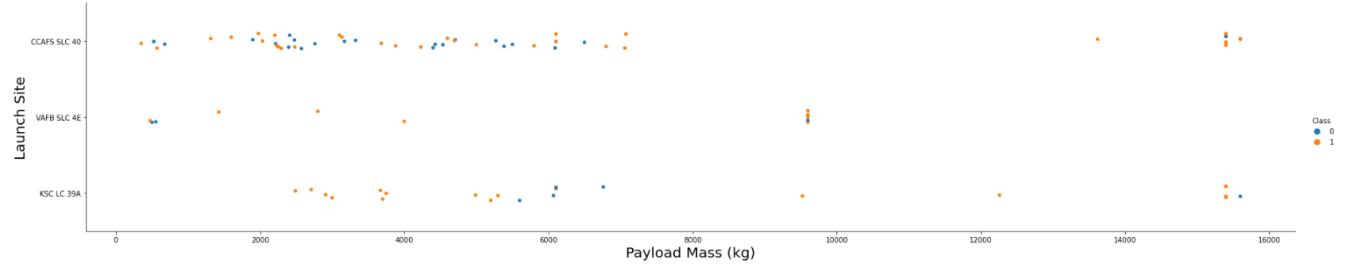
Success Factor: Payload and Launch Site
Launch site VAFB SLC 4E does not have payload mass launches over 10,000kg.
Successful landings are more frequent for the other two sites with higher payloads, however unsuccessful landings are not eliminated.

Slide 15
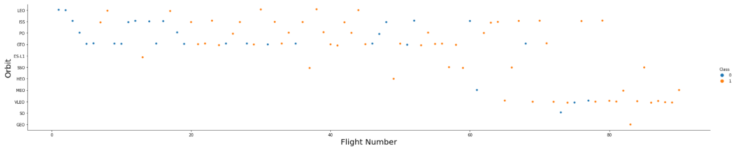
Success Factor: Flight Number and Orbit
Higher rates of successful outcomes based on flight number (passage of time + experience) are identified in the scatterplot for orbit types LEO, ISS, MEO, and VLEO.
Success rates for the orbit types GTO and PO do not appear to be related to flight number (time + experience)
With limited launches for the orbit types SSO, HEO, and GEO (only successful outcomes) and the orbit type SO (only an unsuccessful outcome) it would be imprudent to assess any effect of flight nubmer against the success rate for these launch types.

Slide 16
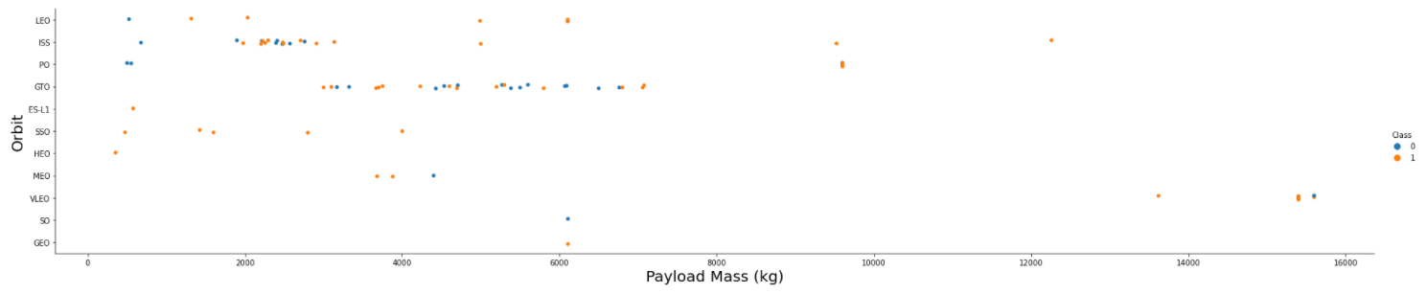
Success Factor: Payload and Orbit
Higher successful landing rates as payload mass increases are associated with the orbits: Polar, LEO, and ISS.
The GTO and VLEO orbits do not appear to have payload mass as a factor in positive or negative landing success.

Slide 17
EDA with SQL Results
Landing Outcome | Count of Outcomes | Rank of Outcomes
No attempt | 10 | 8
Success (drone ship) | 5 | 6
Failure (drone ship) | 5 | 6
Success (ground pad) | 3 | 4
Controlled (ocean) | 3 | 4
Uncontrolled (ocean) | 2 | 2
Failure (parachute) | 2 | 2
Precluded (drone ship) | 1 | 1
Note that this analysis of outcomes is for the date range 2010-06-04 to 2017-03-20 only.
Given the span of time (almost 7 years), it is interesting to note that “No attempt” has a total outcome count of 10 for those years, and the earlier identification of an anomalous result for the success rate in 2018 had a count of 6 “No attempt” outcomes.
Of note, the dataset for the SQL analysis included an additional 11 lines of data (101 records versus 90 lines in the datasets used for all other analyses) and 4 launch sites.
See the Appendix for the full slate of SQL tasks for the analysis.

Slide 18
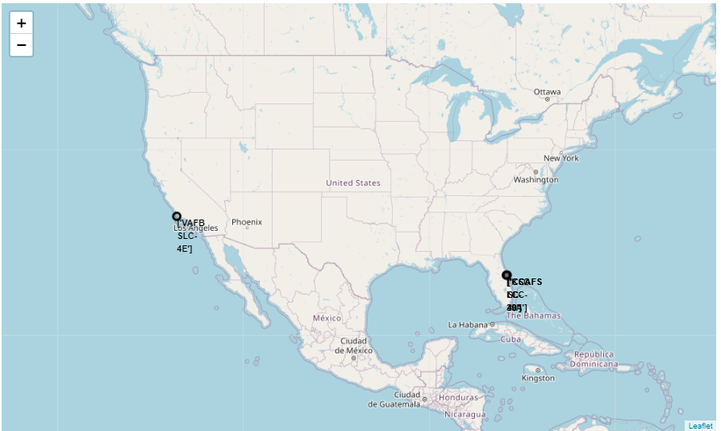
Interactive Map – Launch Site Locations
The SpaceX launch sites are on the east (state of Florida, count of 3) and west (state of California, count of 1) coasts of the United States of America (US).
The locations are also in the southern portion of the US, and given the geopolitical borders, are located in proximity to the equator (given the geopolitical borders for each coast).
This analysis used the provided dataset “spacex_launch_geo.csv” which identified 4 launch sites.

Slide 19
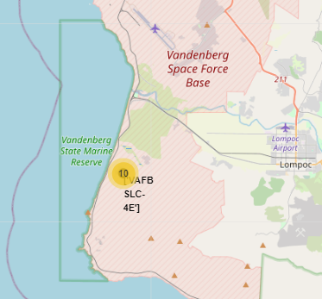
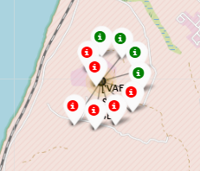
Interactive Map – California VAFB SLC-4E
The SpaceX launch site (Vandenberg Space [Air] Force Base) on the west coast (state of California) of the United States of America (US).
All the launch records for this site have the exact same coordinates. Therefore, the use of Marker clusters has been used to simplify the map presentation of the results.
Expanding the detail behind the marker cluser enables the pop-up markers that provide the detail on the launch site success rate.
Successful launches (class=1), are displayed with a green marker, and unsuccessful launches (class=0), the display uses a red marker.

Slide 20
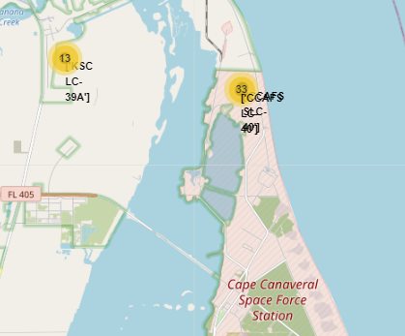
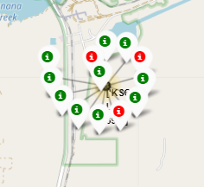
Interactive Map – Florida KSC-LC 39A
The SpaceX launch site KSC-LC 39A (Kennedy Space Centre) on the east coast (state of Florida) of the United States of America (US).
All the launch records for this site have the exact same coordinates. Therefore, the use of Marker clusters has been used to simplify the map presentation of the results.
Expanding the detail behind the marker cluser enables the pop-up markers that provide the detail on the launch site success rate.
Successful launches (class=1), are displayed with a green marker, and unsuccessful launches (class=0), the display uses a red marker.

Slide 21
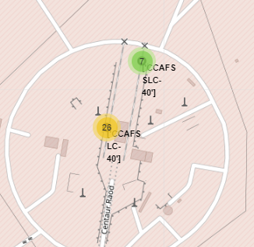
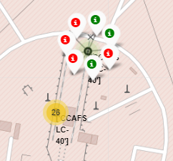
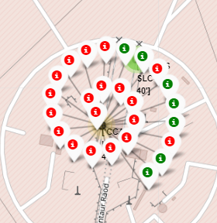
Interactive Map – Florida CCAFS (S)LC-40¹
The SpaceX launch site CCAFS (S)LC-40 (Cape Canaveral Space [Air] Force Station) on the east coast (state of Florida) of the United States of America (US).
All the launch records for this site apply to 1 of 2 sets of coordinates (“old name” CCAFS LC-40 and “new name” CCAFS SLC-40). Therefore, the use of Marker clusters has been used to simplify the map presentation of the results, and both coordinate sites for this single launch site are displayed.
Expanding the detail behind the marker cluser enables the pop-up markers that provide the detail on the launch site success rate. Successful launches (class=1), are displayed with a green marker, and unsuccessful launches (class=0), the display uses a red marker.
From the course discussion forum: “The site was repaired and returned to operational status in Dec 2017, and since that time the old API starts to use CCAFS SLC-40. Then the another updated API discarded the old name CCAFS LC-40. The concerned team will update the two visual analytic lab to use latest dataset.” The update appears to remain pending.

Slide 22
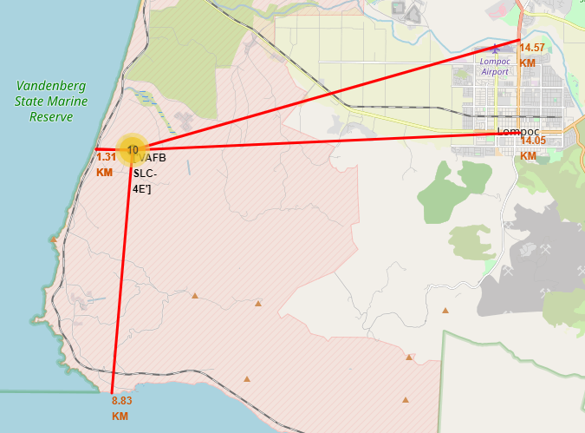
Interactive Map – Landmark Distances
Exploration and analysis of the proximities of launch site: VAFB SLC-4E
Railway proximity: 1.31km
Highway proximity: within 15 km
Coastline proximity: non marine reserve coastline less than 9km; however, coastline within the Vandenberg State Marine Reserve is much closer, similar distance as railway proximity.
Proximity to city: closest urban area just over 14km

Slide 23
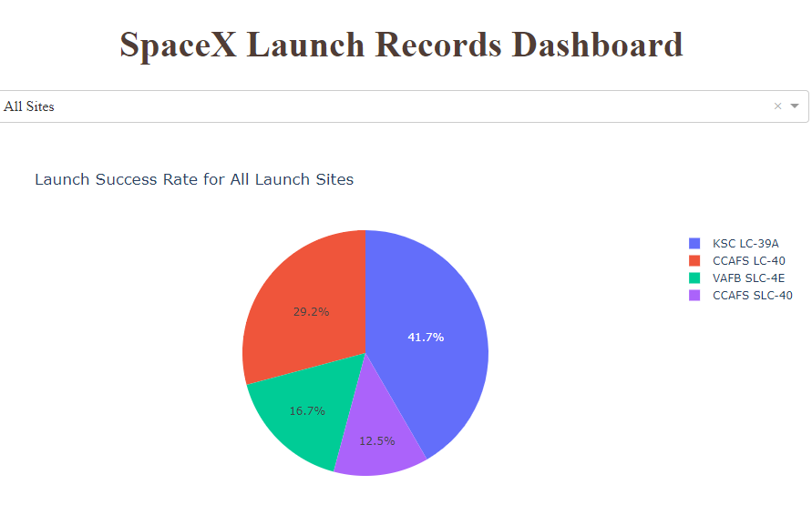
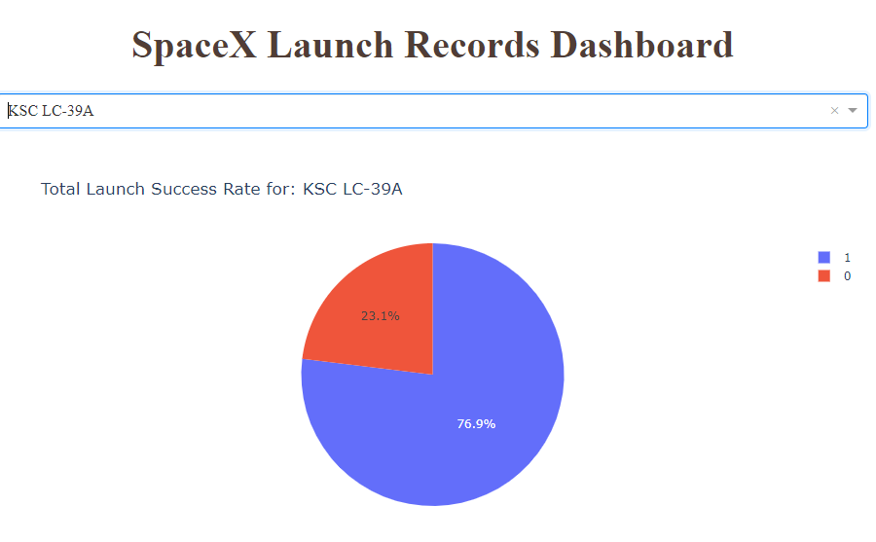
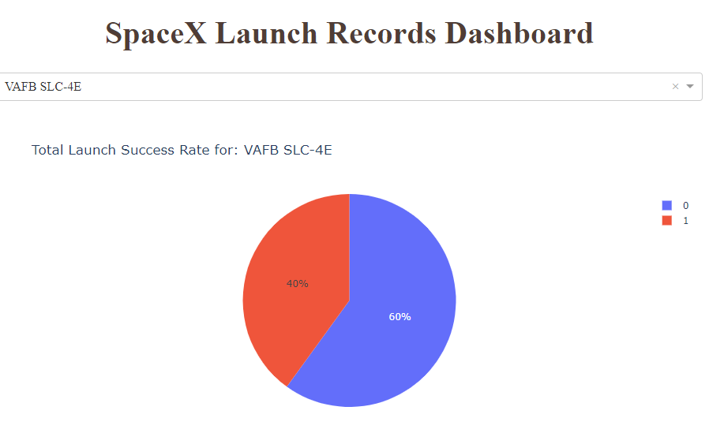
Dashboard Results: Launch Success Rate
Using the interactive dashboard analysis, the pie chart indicated that the Kennedy Space Centre site had the highest launch success rate. The successful versus unsuccessful launch outcomes for the Kennedy Space Centre were selected using the drop-down menu. For comparison, the successful versus unsuccessful launch outcomes for the Vanderberg Space [Air] Force Base site were also selected for display.
This interactive dashboard analysis used a different provided dataset “spacex_launch_dash.csv”

Slide 24
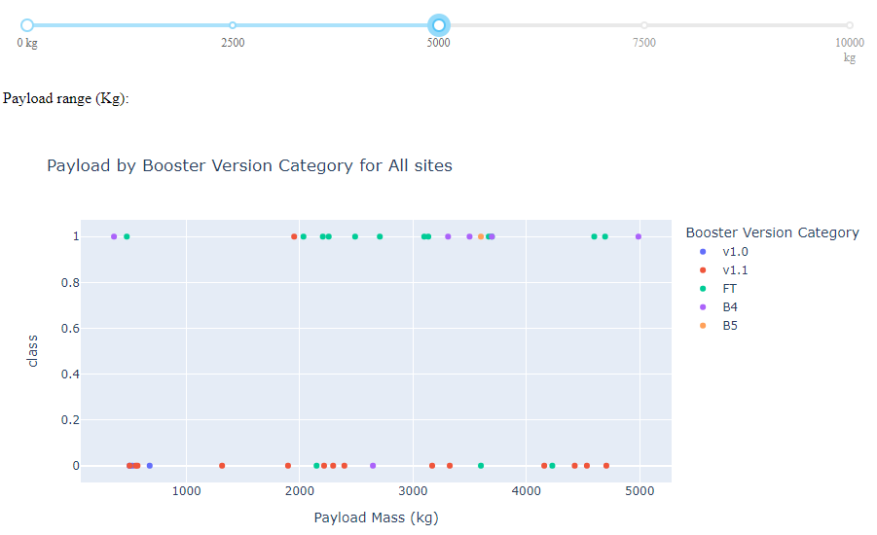
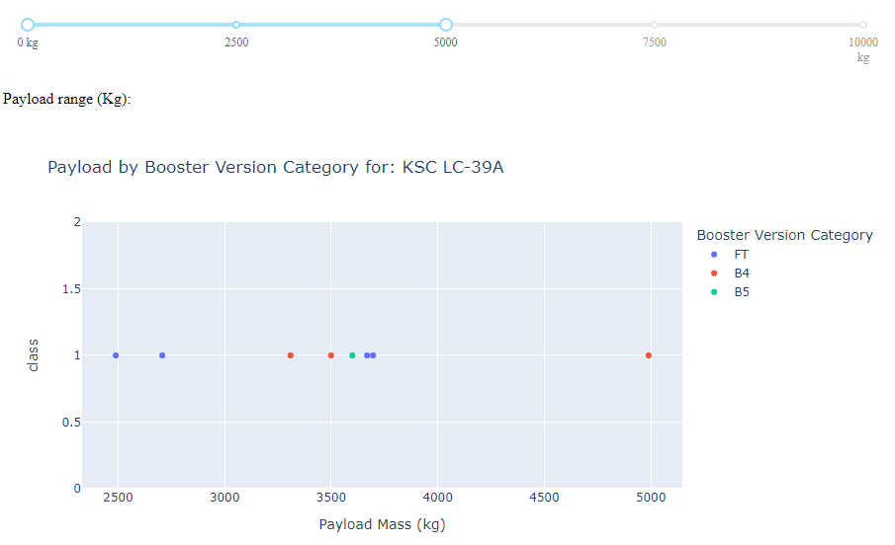
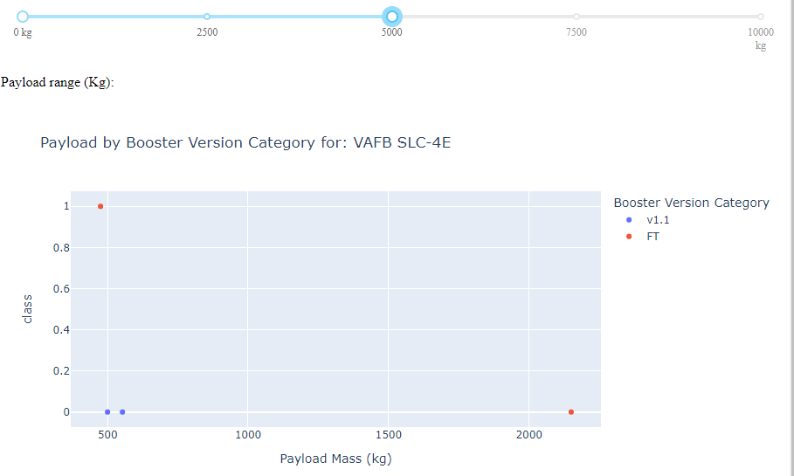
Dashboard Results: Payload 0-5000kg
Using the Payload range slider aspect of the dashboard, for all sites the success rate for 0-5000kg payloads is similar to the unsuccessful outcomes, for the Kennedy Space Centre has 100% success for this payload range. In comparison, the Vanderberg Space [Âir] Force Base has a 25% success rate in this payload range.

Slide 25
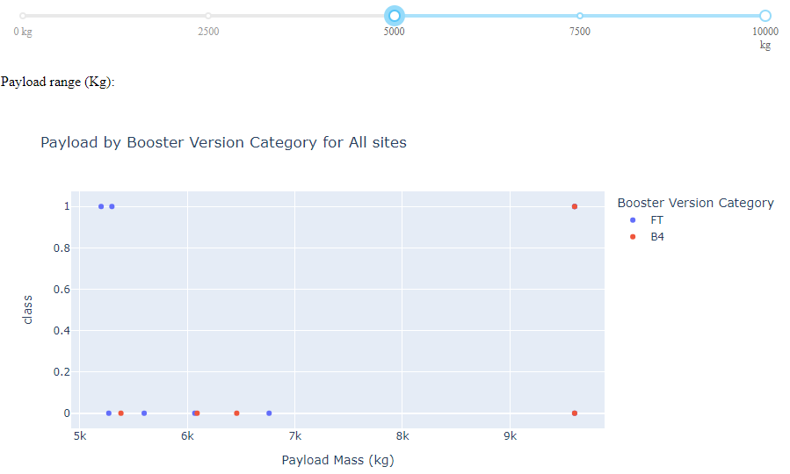
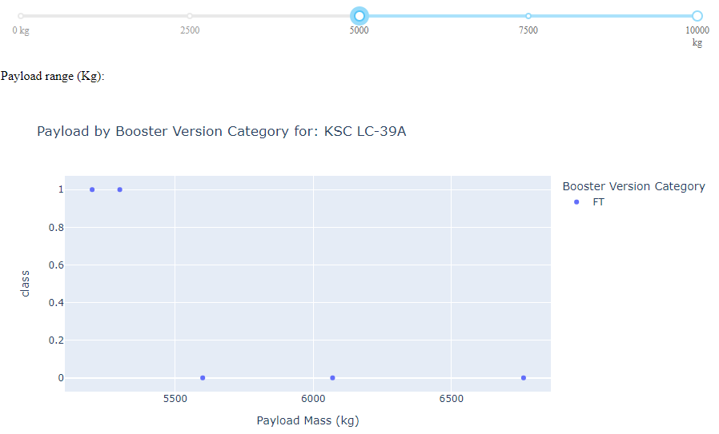
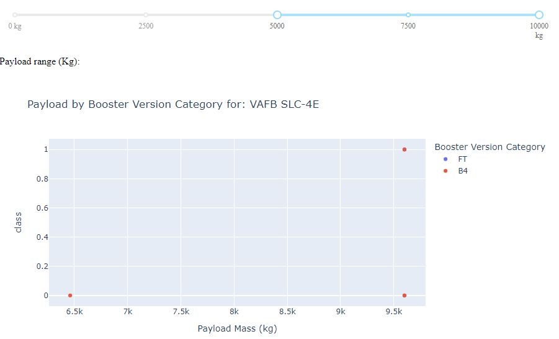
Dashboard Results
Adjusting the payload mass slider to 5000-10,000kg, the success rate for all sites is significantly lower, with breakouts for the same two sites shown.

Slide 26
Predictive Analysis Results
Accuracy identifies the best performing algorithm as Support Vector Machine Method (0.0018 higher than Logistic Regression).
Jaccard Index and F1-Score both identify the K Nearest Neighbor algorithm as the best performing method.

Slide 27
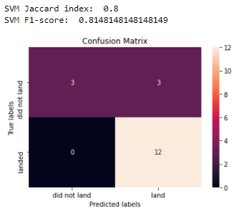
Predictive Analysis Results
The Confusion Matrix for the Support Vector Machine Method identifies that the major problem is false positives.

Slide 28

DISCUSSION
The purpose of this analysis is to identify the various factors that influence successful launch outcomes for SpaceX.
Lessons learned (time + experience) is a significant factor.
Payload, orbit, and launch site are interrelated factors.

Slide 29

CONCLUSION
The best machine learning model for this dataset was the Support Vector Machine model.
The overarching factor for successful outcomes for launches is related to time and experience (learning curve)
Success rate for higher weighted payloads is affected by orbit while the success rate for low weighted payloads is affected by launch site.
Orbit types that have a higher success rate than others are: ES-L1, GEO, HEO, SSO, VLEO (to a lesser extent)
The instances of “no attempt” to land the stage 1 rocket depress the success rate without providing any useful data on the undesired outcome, as the choice was made to essentially sacrifice the stage 1 rocket for that flight.

Slide 30
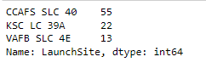
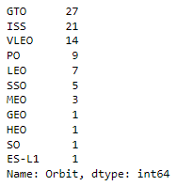
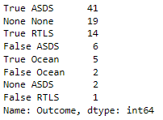
APPENDIX
Number of Launches by Site
Number of Launches by Orbit
Number of Launches by Mission Outcome

Slide 31
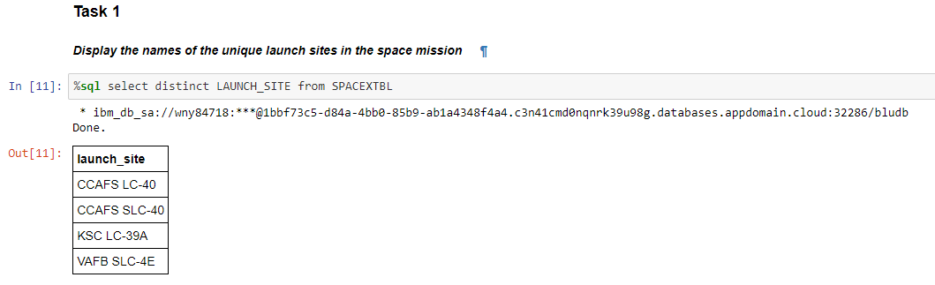
APPENDIX EDA using SQL Task 1

Slide 32
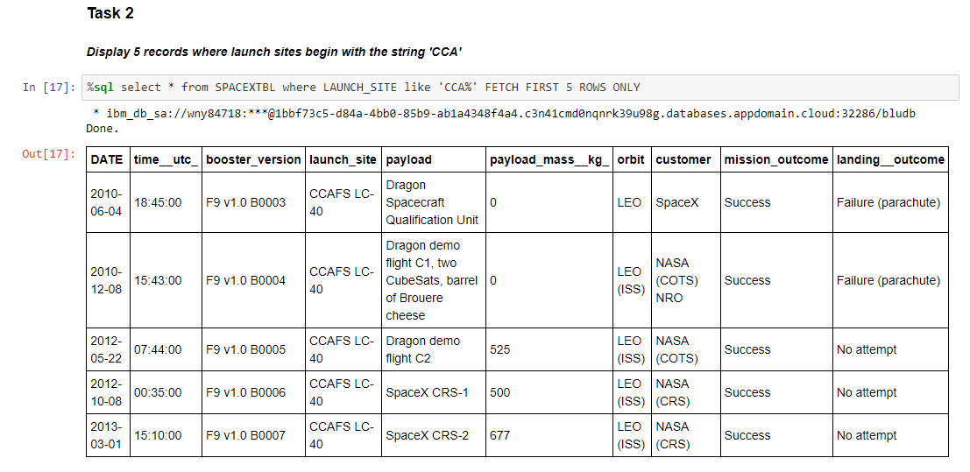
APPENDIX EDA using SQL Task 2

Slide 33
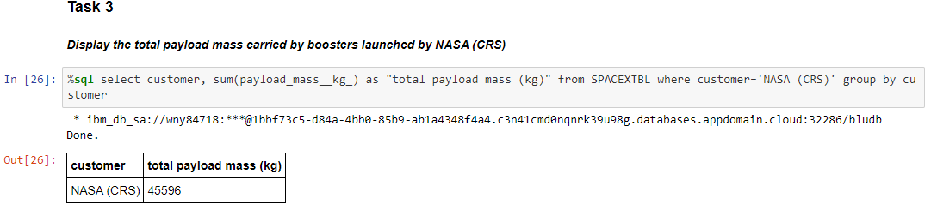
APPENDIX EDA using SQL Task 3

Slide 34
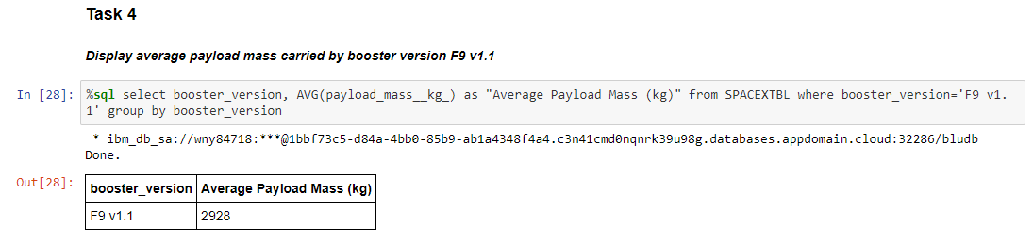
APPENDIX EDA using SQL Task 4

Slide 35
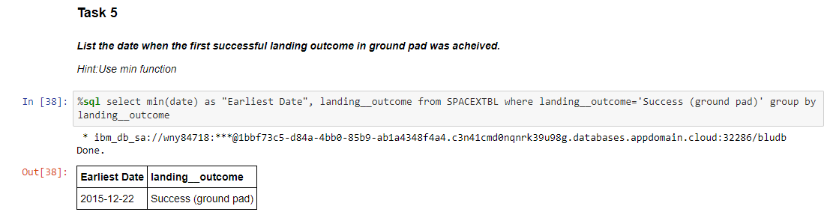
APPENDIX EDA using SQL Task 5

Slide 36
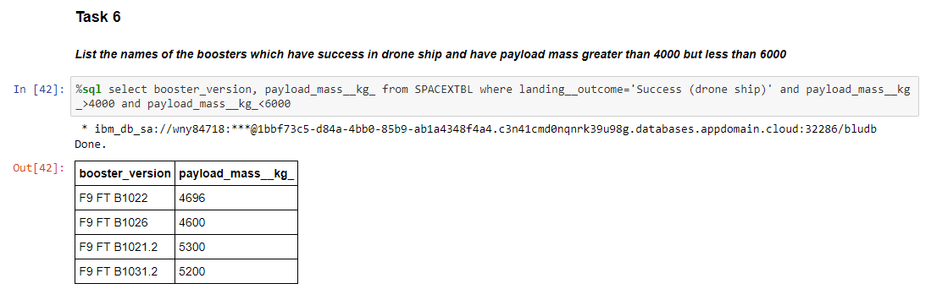
APPENDIX EDA using SQL Task 6

Slide 37
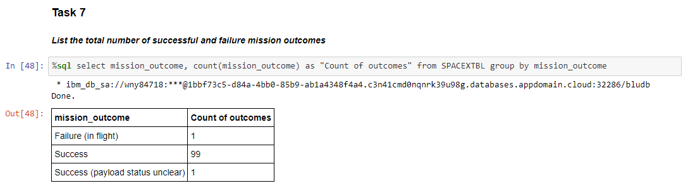
APPENDIX EDA using SQL Task 7

Slide 38
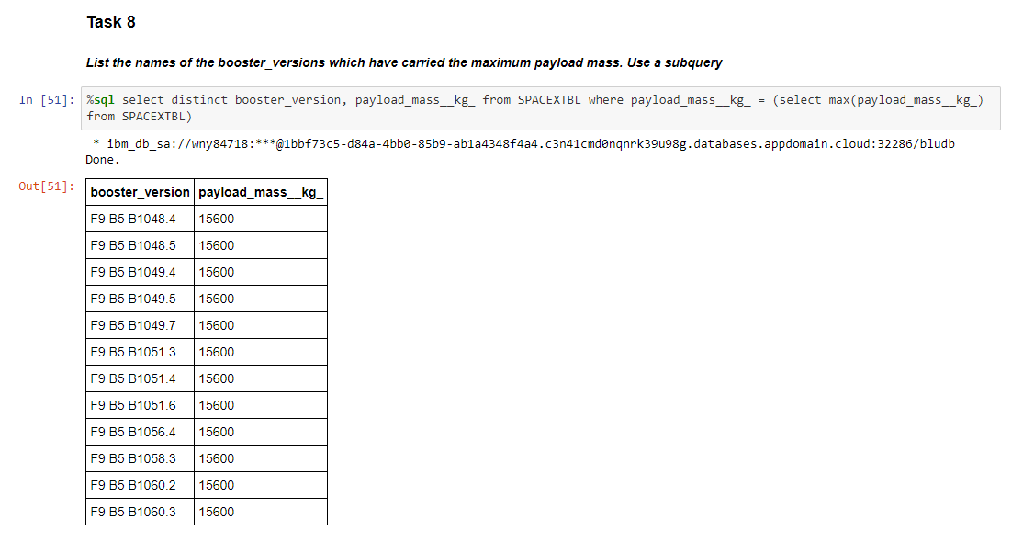
APPENDIX EDA using SQL Task 8

Slide 39
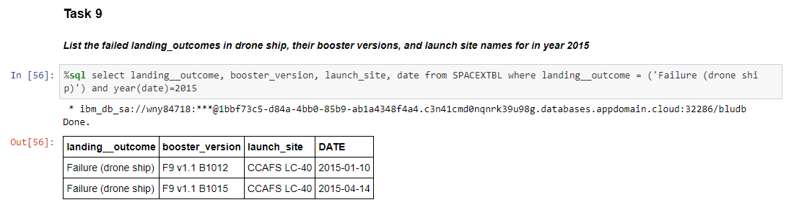
APPENDIX EDA using SQL Task 9

Slide 40
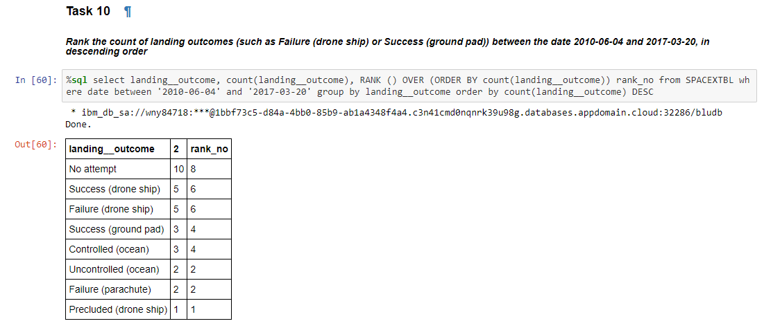
APPENDIX EDA using SQL Task 10

Slide 41
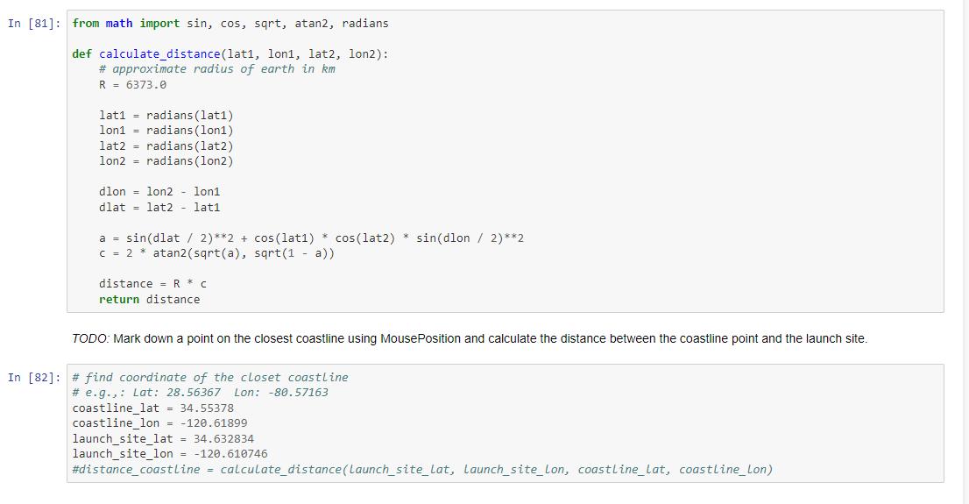
APPENDIX Folium – distance calculation

Slide 42
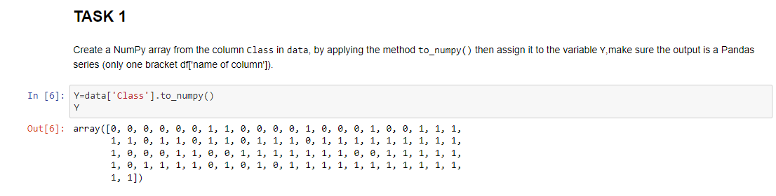
APPENDIX Machine Learning: Task 1

Slide 43
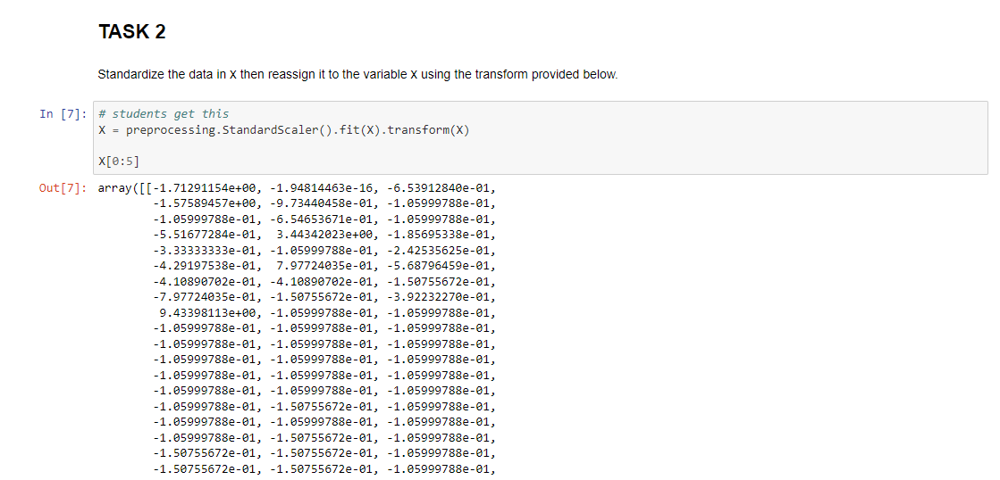
APPENDIX Machine Learning: Task 2

Slide 44
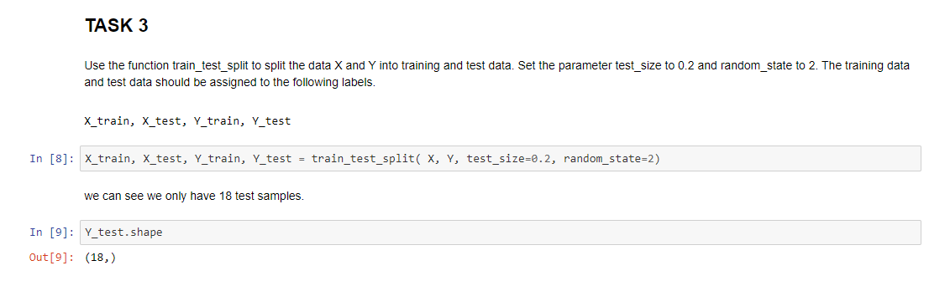
APPENDIX Machine Learning: Task 3

Slide 45

APPENDIX Machine Learning: Task 4

Slide 46

APPENDIX Machine Learning: Task 5

Slide 47

APPENDIX Machine Learning: Task 6

Slide 48

APPENDIX Machine Learning: Task 7

Slide 49

APPENDIX Machine Learning: Task 8

Slide 50

APPENDIX Machine Learning: Task 9

Slide 51

APPENDIX Machine Learning: Task 10a

Slide 52

APPENDIX Machine Learning: Task 10b

Slide 53

APPENDIX Machine Learning: Task 10c

Slide 54

APPENDIX Machine Learning: Task 11

Slide 55

APPENDIX Machine Learning: Task 12

Slide 56
REFERENCES
SpaceX Falcon 9 landing image (cover page) sourced from Wikipedia page “Falcon 9”: https://en.wikipedia.org/wiki/Falcon_9
SpaceX data source: Wikipedia page “List of Falcon 9 and Falcon Heavy launches” as of 2021-06-09: https://en.wikipedia.org/w/index.php?title=List_of_Falcon_9_and_Falcon_Heavy_launches&oldid=1027686922
Table of contents image source Dreamstime: table-contents-write-document-isolated-blue-background-166839122.jpg (800×533) (dreamstime.com)
Interactive Dashboard data source: https://cf-courses-data.s3.us.cloud-object-storage.appdomain.cloud/IBM-DS0321EN-SkillsNetwork/datasets/spacex_launch_dash.csv
Executive Summary image from Shutterstock.com
Welcome (Introduction) word cloud source: istockphoto.com -- welcome-phrase-words-cloud-concept-picture-id481560677 (612×442) (istockphoto.com)
Data collection image from www.ceros.com -- data-collection.png (1013×786) (xcademy.in)
Methodology word cloud source: istockphoto.com -- methodology-word-cloud-concept-4-illustration-id683486486 (1024×739) (istockphoto.com)
Predictive analytics image from ibm.com: predictive_bi.png (693×515)
Discussion image from Discussionlistservices.com: discussion.jpg (1280×960) (discussionlistservices.com)
Conclusion image (« The End ») from Excelsior College: conclusion.jpg (660×340) (excelsior.edu)

